Slide 1
3D Face Reconstruction
Arnaud Lhomme, s2397447
Ángel Lorente Rogel, s2413159
Guillermo Rodríguez, s2421771

Slide 2


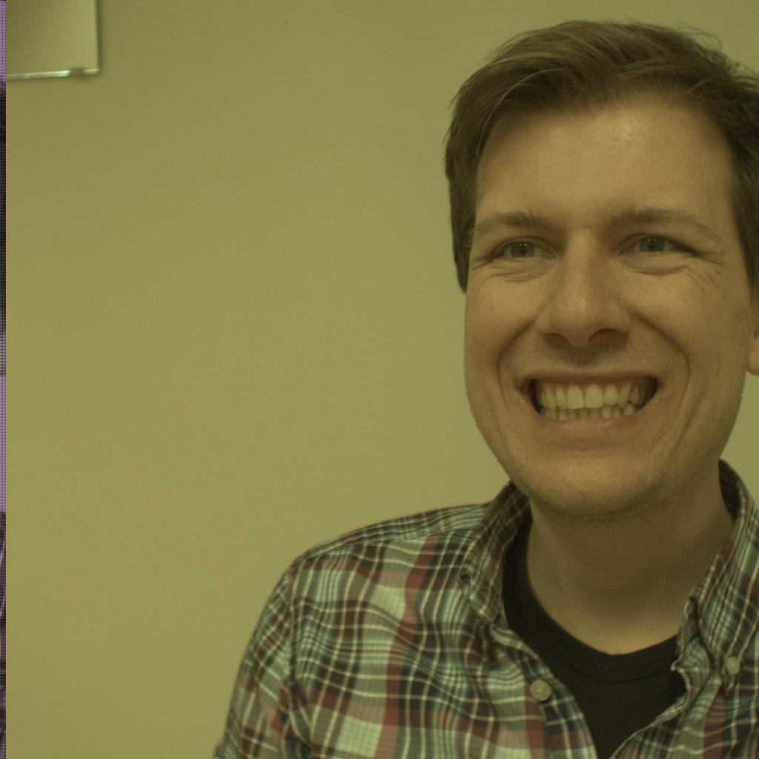
Goal
Design a method for the creation of the 3D surface meshes of the faces of subjects

Slide 3
Camera Calibration

Slide 4
Stereo Rectification

Slide 5

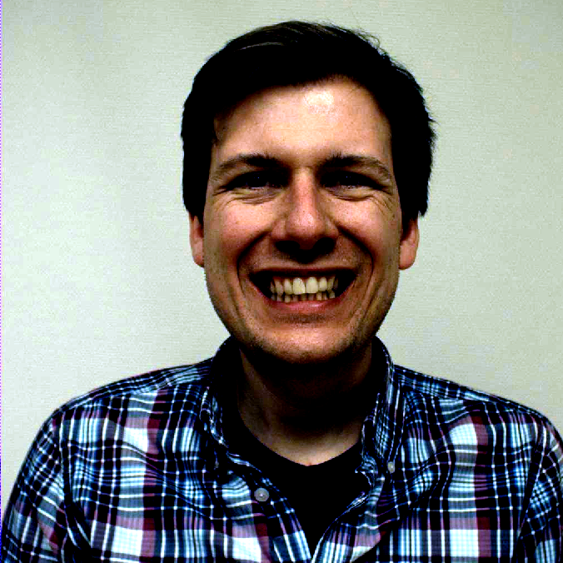
Colour Normalization

Slide 6
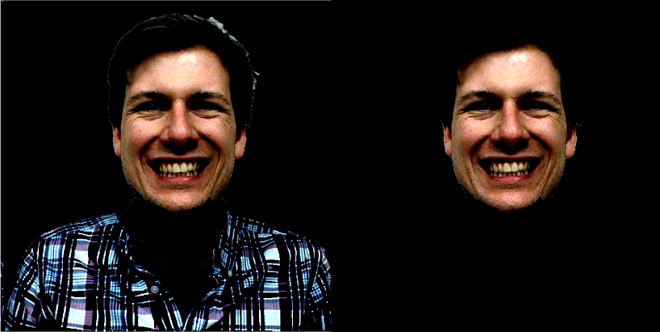
Face Detection
Background removal with edge detection algorithm
Face extraction with skin detection algorithm

Slide 7
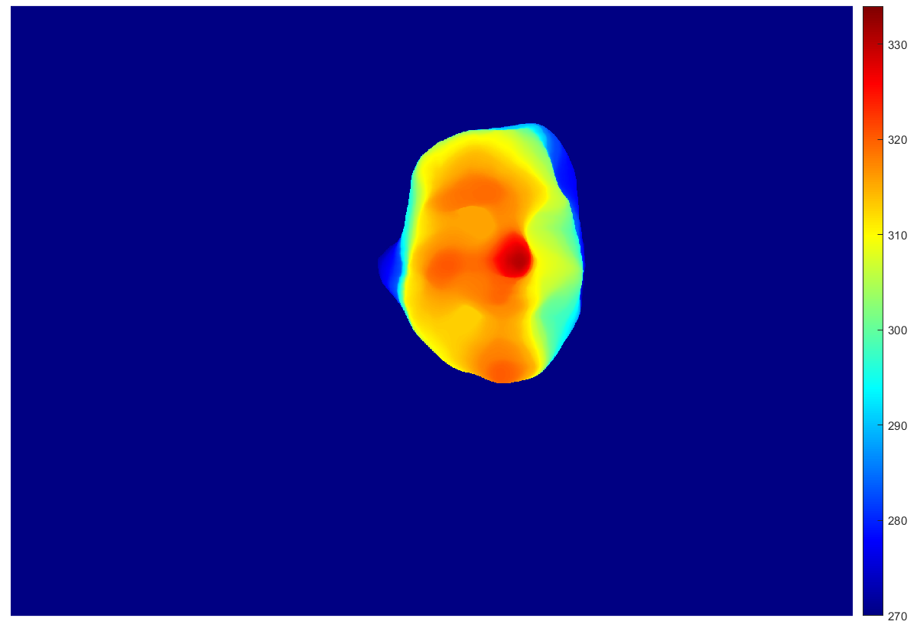
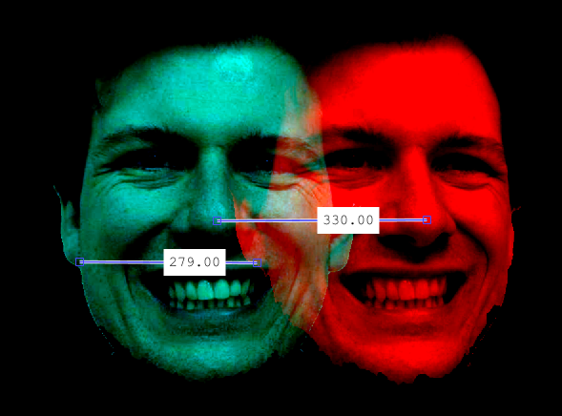
Disparity Maps
Disparity range obtained graphically
Disparity map created with Semi-Global Matchin algorithm

Slide 8
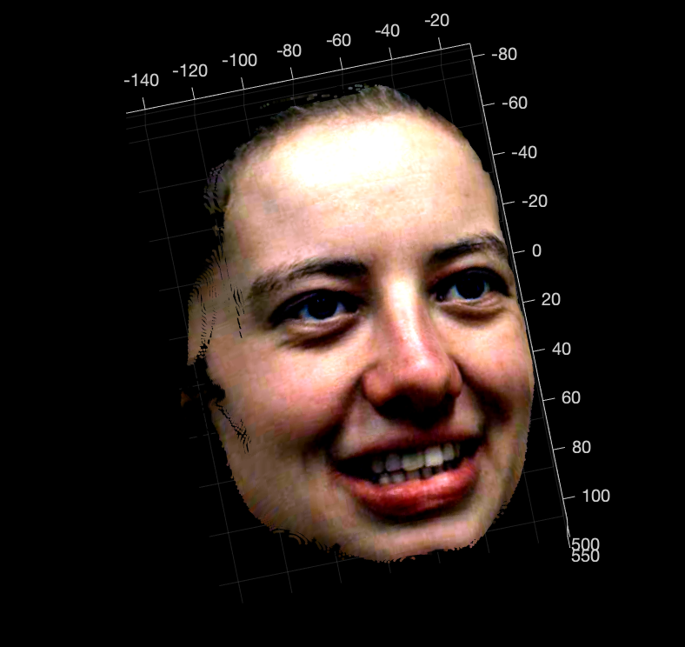
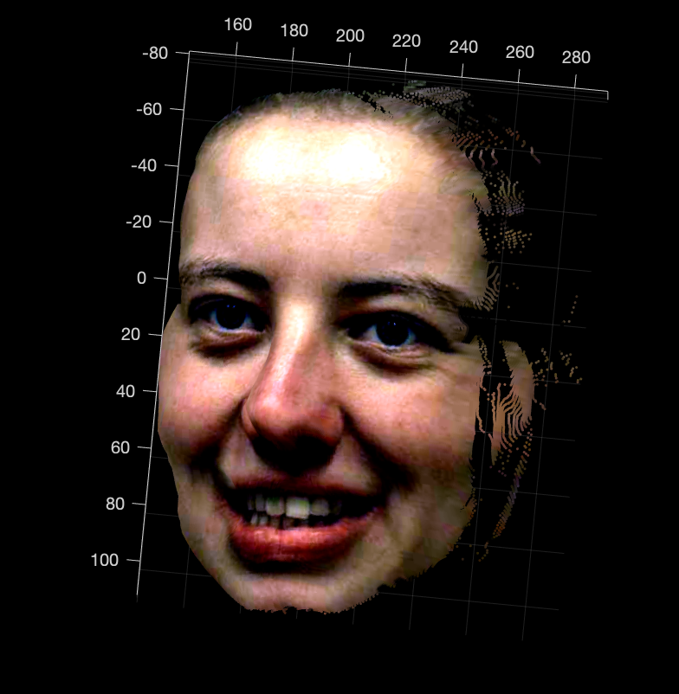
3D Point Clouds

Slide 9
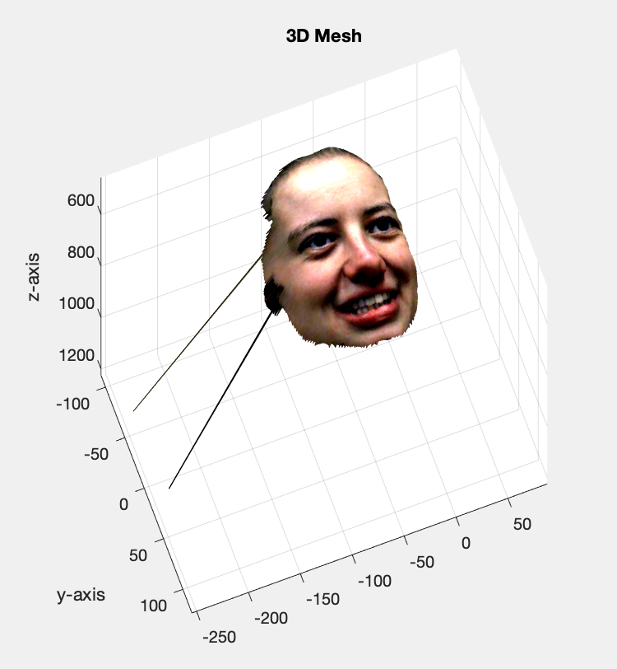
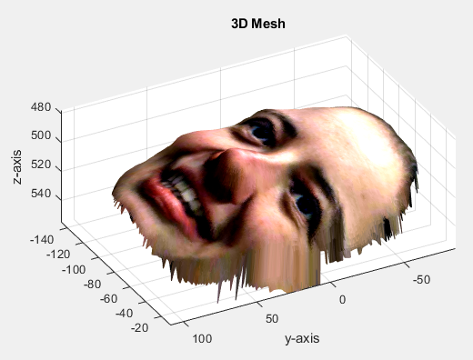
3D Mesh Reconstruction

Slide 10
Conclusion

